Slide 1
Coronavirus or COVID-19
General Board of Global Ministries

Slide 2
Disclaimer
All information included in this presentation is derived from US Centers for Disease Control and Prevention (CDC) and the World Health Organization (WHO).
Information pertaining to Coronavirus is subject to change per CDC and WHO guidance
This presentation was distributed on March 19, 2020

Slide 3
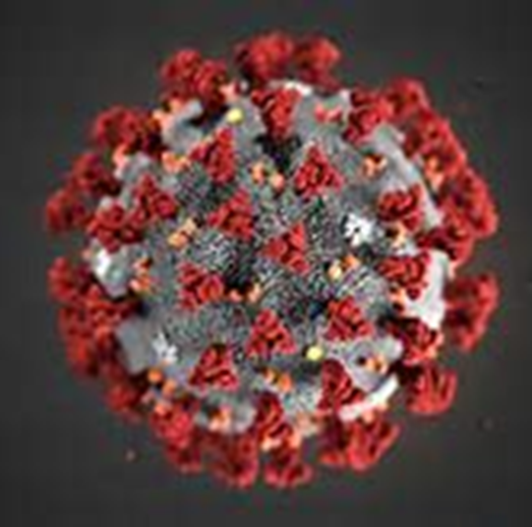
What is a novel coronavirus?
Coronavirus (CoV) are a large family of viruses, cause a wide range of illnesses from the common cold to more severe illnesses
  Examples: Severe Acute Respiratory Syndrome (SARS) and Middle East Respiratory Syndrome (MERS)
A novel coronavirus is a new strain that has not been previously identified in humans

Slide 4
History: COVID-19
December 31, 2019: The World Health Organization (WHO) was informed of pneumonia cases of unknown causes in Wuhan City
January 7, 2020: A novel coronavirus was isolated as the cause
January 21, 2020: First case of COVID-19 in the US detected
January 30, 2020: WHO declared “Public Health Emergency of International Concern”
March 11, 2020: WHO declares COVID-19 a pandemic
  Over 118,000 cases of the coronavirus illness in over 110 countries and territories around the world and the sustained risk of further global spread

Slide 5
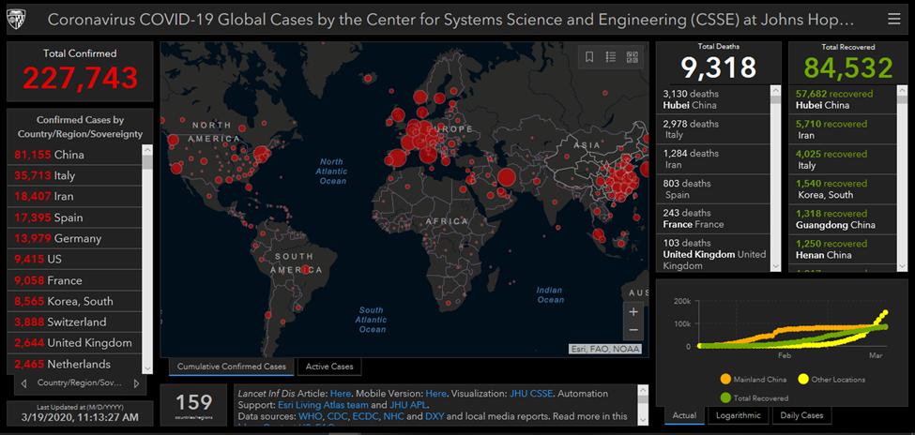
Countries affected:
Last Updated 3/19/2020: Click picture to access updated information

Slide 6
COVID-19
Incubation period, the period between exposure to an infection and the appearance of the first symptoms: Ranges from 1 to 14 days¹
  Averages about 5 to 6 days
Mode of transmission: Droplets and contaminated surfaces¹
Transmission: Human to human²
Treatment: Currently no vaccination, trying several treatments that are found effective for viruses, treatment of symptoms¹
1: This information is subject to change.
2: In majority of cases

Slide 7
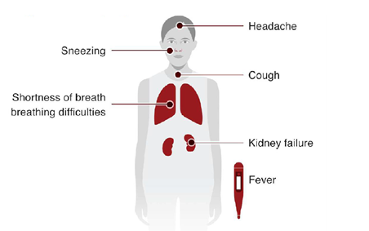
COVID-19 Signs and Symptoms
Illness appears to start with fever,
Followed by a dry cough
Can lead to shortness of breath
Some patients may need to be hospitalized.

Slide 8
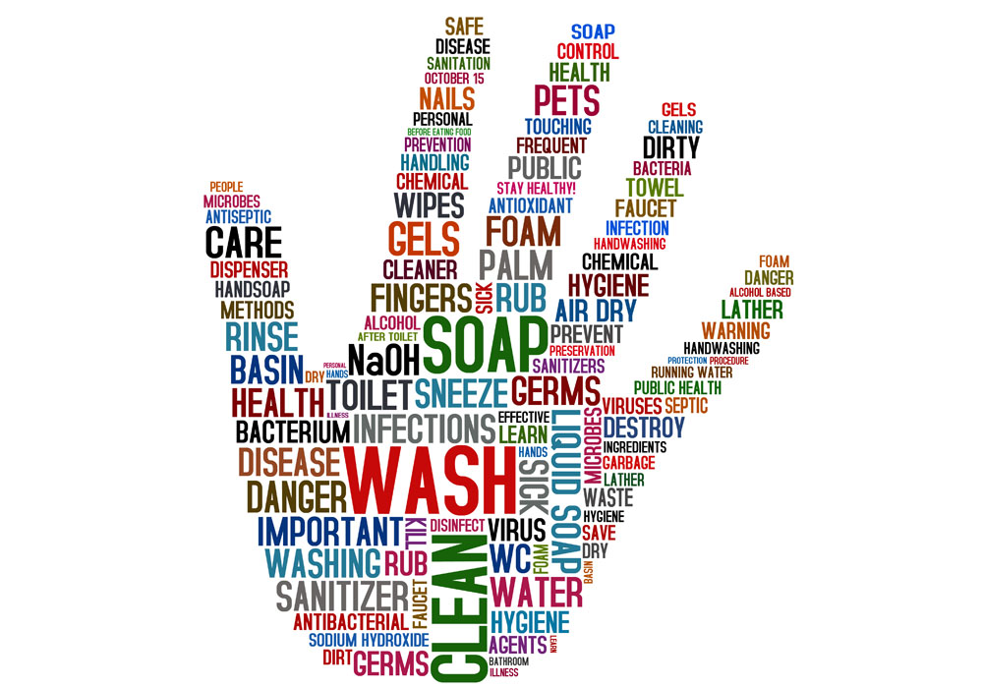
Infection Prevention and Control

Slide 9
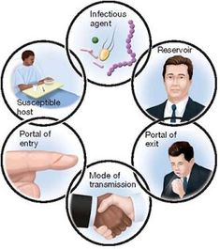
How do colds and viruses spread?
For an infection to spread, all links must be connected
Breaking any one link, will stop disease transmission!

Slide 10
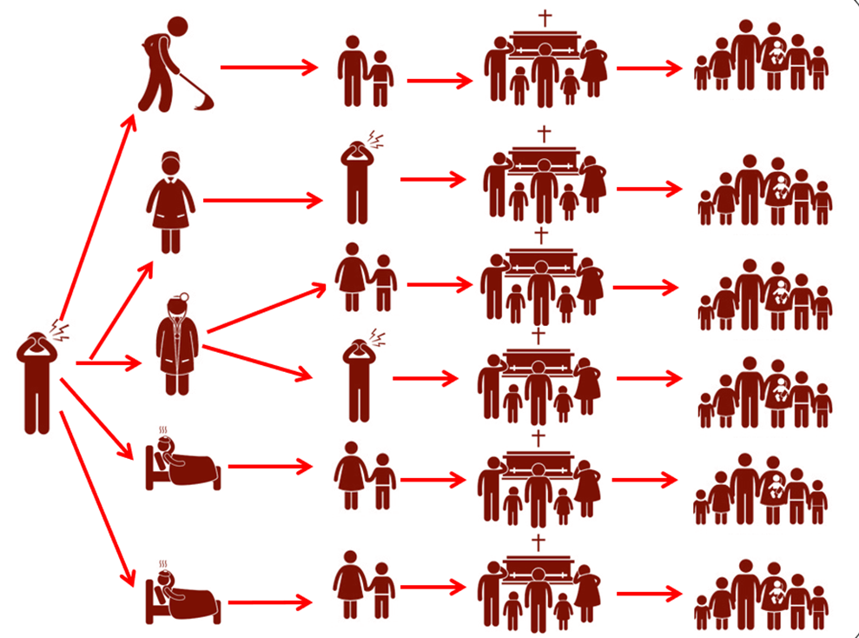
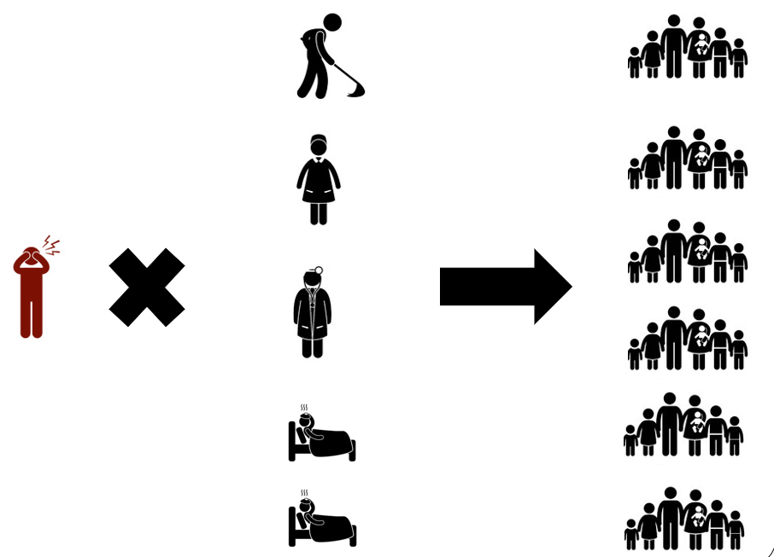
Infection Prevention and Control (IPC)
Without breaking the transmission chain
With breaking the transmission chain

Slide 11
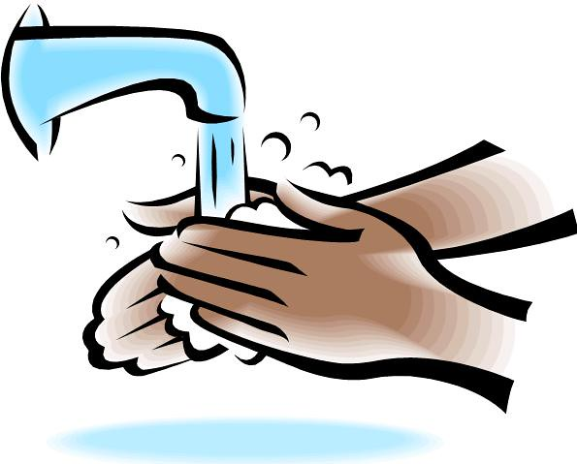


Basic Prevention Measures
Hand Hygiene
Respiratory hygiene
Social distancing

Slide 12

When should you clean your hands? | Before | During | After
Preparing food
Eating
Blowing nose, coughing and sneezing
Caring for someone
Touching animals, animal feed, animal waste
Touching garbage
Using the toilet
Touching money
Touching your face and nose

Slide 13
When to perform hand hygiene?
When should you clean your hands? | Before | During | After
Preparing food | ü | ü | ü
Eating | ü |  | ü
Blowing nose, coughing and sneezing |  |  | ü
Caring for someone | ü | ü | ü
Touching animals, animal feed, animal waste |  |  | ü
Touching garbage |  |  | ü
Using the toilet |  |  | ü
Touching money |  |  | ü
Touching your face and nose | ü |  | ü

Slide 14

Frequently clean your hands…
When your hands are visibly dirty:
  Use soap and water
When your hands are not visibly soiled:
  Use alcohol-based hand rub (Hand sanitizer)
    or
  Soap and water
  Washing hands is the BEST way to prevent the spread of
  infections!!

Slide 15
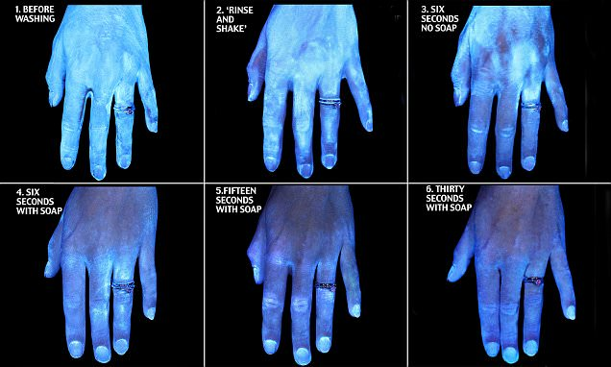
GloGerm Presentation
Please note that at 30 seconds, germs are still present on the hands.

Slide 16
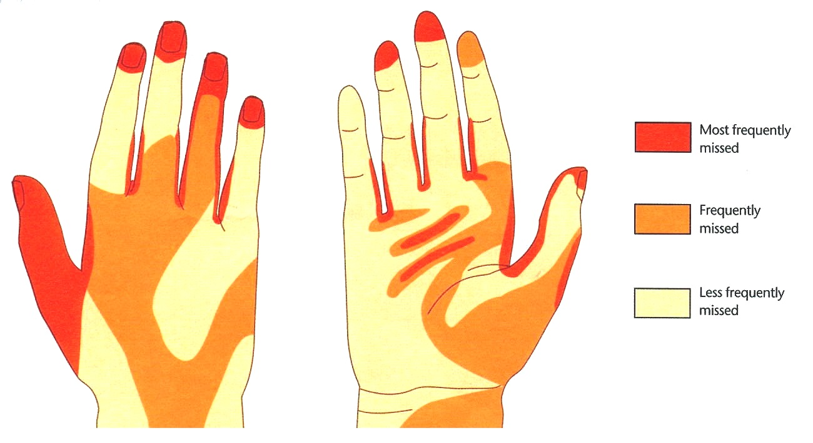
Parts of the Hand that are Usually
Not Washed Properly
Most frequently missed
Frequently missed
Least frequently missed
Back of hand
Front of hand
The use of gloves does NOT replace the need to wash hands. Hand hygiene must be performed after removing gloves.
Notes:
Talking Points: Take a look at this diagram. It shows the parts of the hand that are usually not washed properly. Think about your usual way of hand washing. I think that I have missed these spots on occasion. Would you have missed these spots?
Let’s go through the steps for proper hand washing.

Slide 17
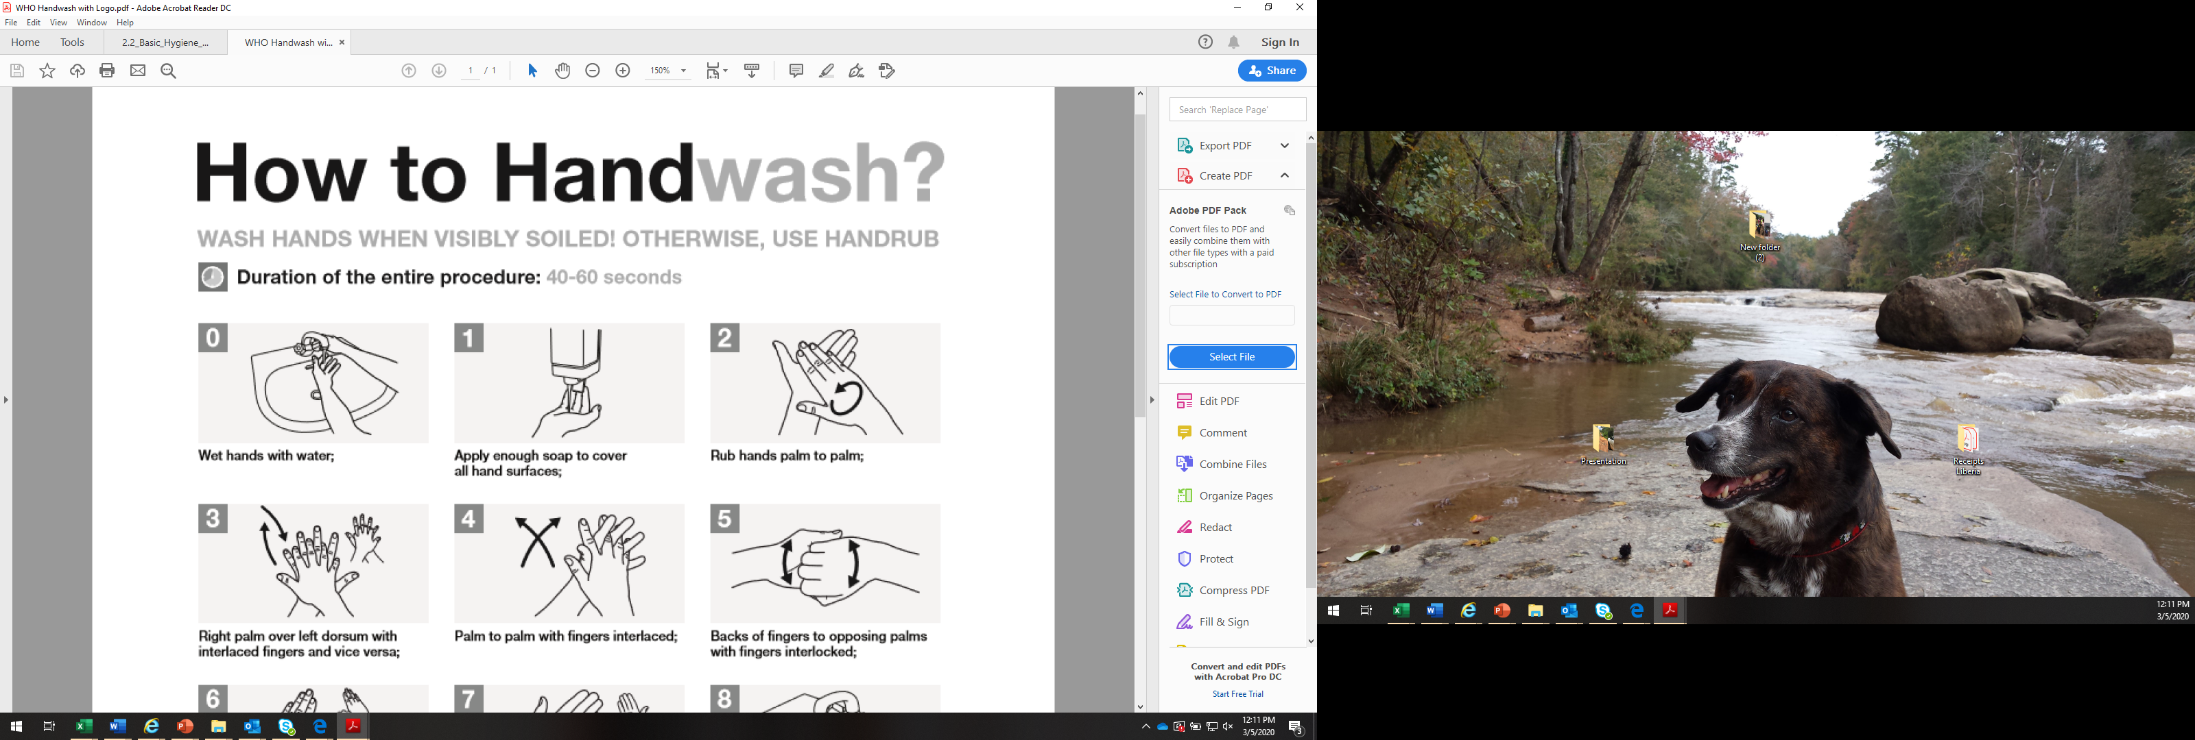
Notes:
We are going to teach you a way to wash your hands that we call the Handwashing Prayer. It is something you should do over and over all day long and you should think of it as a prayer to keep you safe. Lets do the handwashing prayer together!
Everybody put your hands up! **Look at the clock
Activity: Handwashing prayer with hands in the air.
*Explain why you do each step and what parts of the hand you are cleaning. For example the 5th step is to clean the back of the nails, 7th step is to get under the nails.
*can add wrists as 8th step
Break for tea (real handwashing before hand)

Slide 18
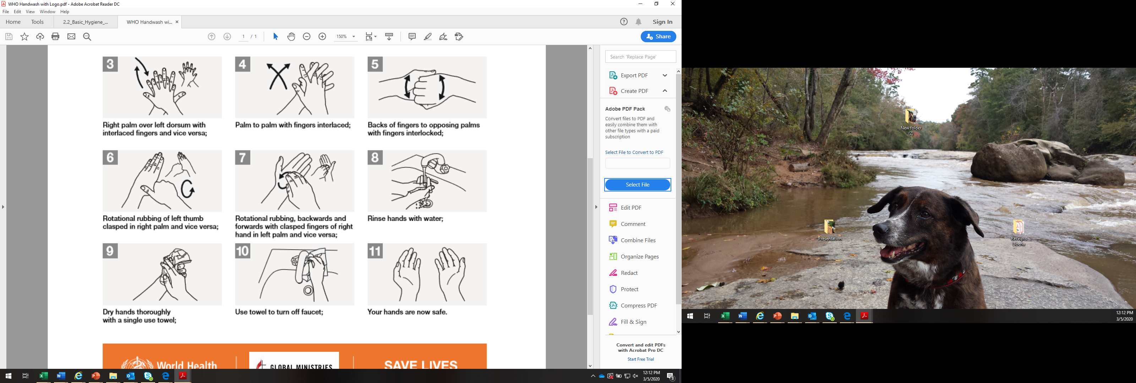

Slide 19
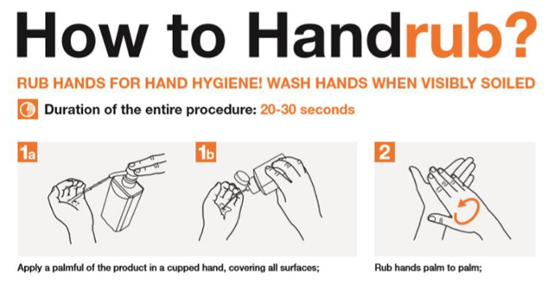

Slide 20
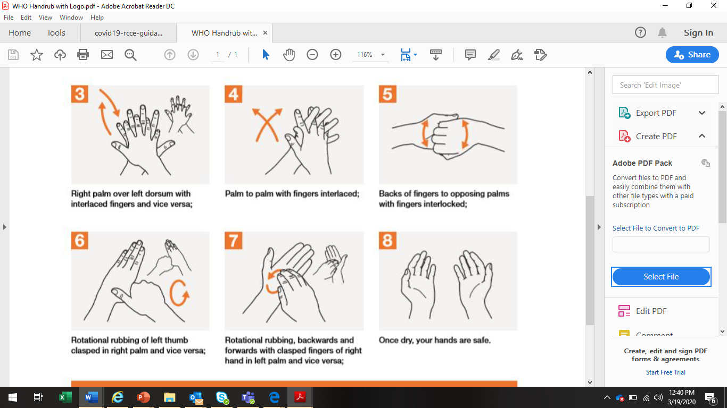

Slide 21
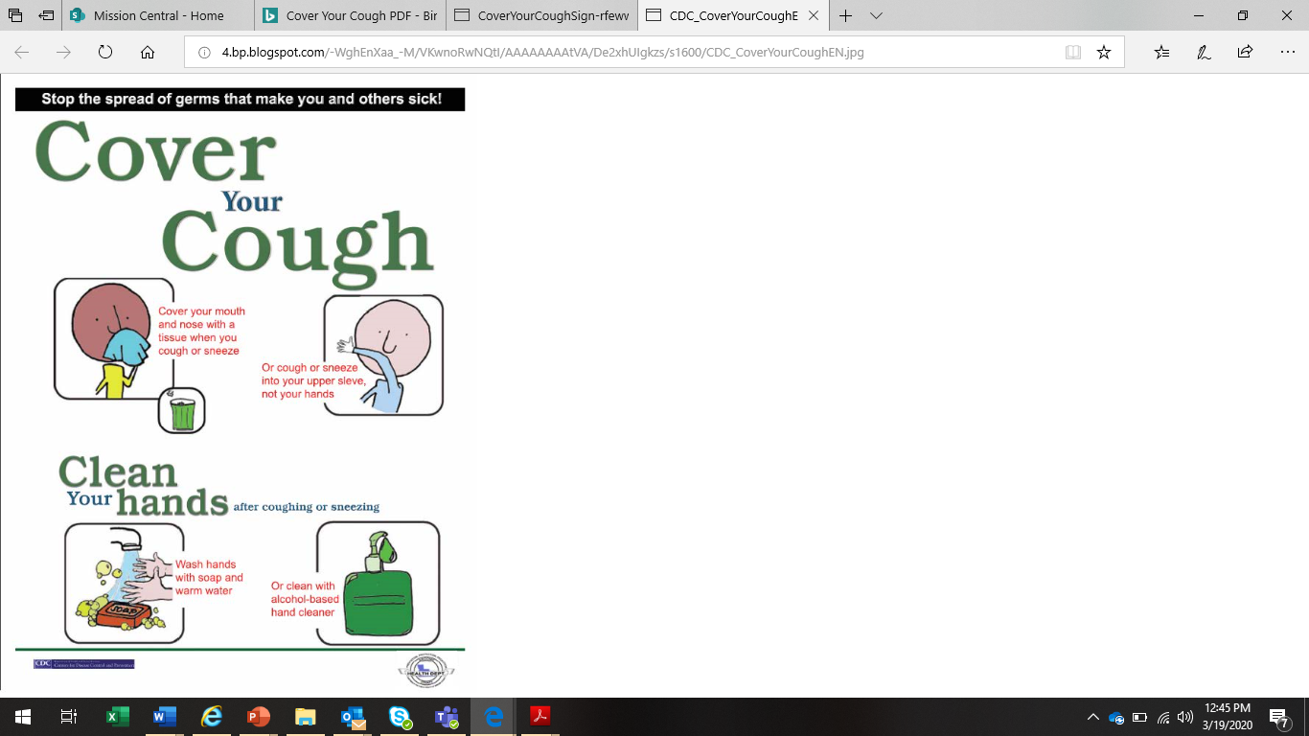
Respiratory Hygiene
Cover your mouth and nose with a disposable tissue when coughing or sneezing
  Discard the tissue immediately into a no-touch waste bin
  Wash your hands afterwards
If you don’t have a tissue, sneeze into your elbow

Slide 22
Social Distancing
Reduce the time spent in crowded places, as the likelihood of coming in contact with people who are ill is greater
Keep distance of at least 6 feet from people who are coughing or sneezing
Avoid touching, hugging, shaking hands or kissing people that are sick
Do not come to work if you have a fever equal or greater than 100.4^{oF} and/or have an active cough

Slide 23
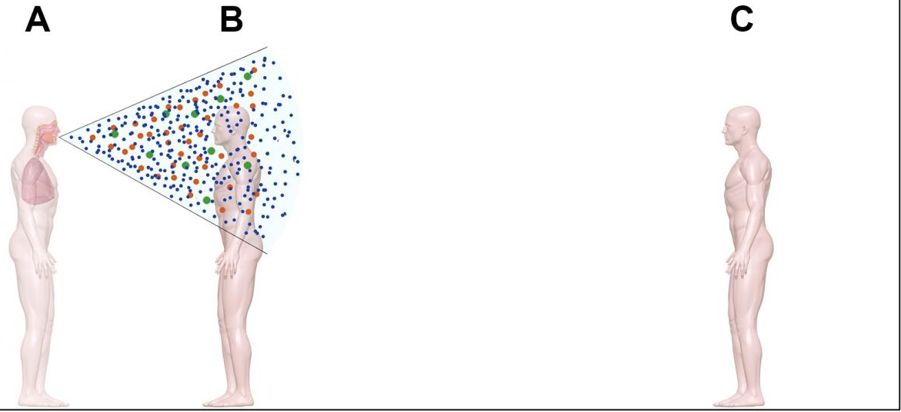
Droplets
Usually generated when a person coughs, sneezes or talks
Travel only short distances through the air as they are larger and heavier
Do not remain suspended in the air
Person A is sick with a respiratory illness
Person B is standing within 3 feet from person A when s/she coughs
Person C is standing more than 6 feet away and is protected from the virus

Slide 24
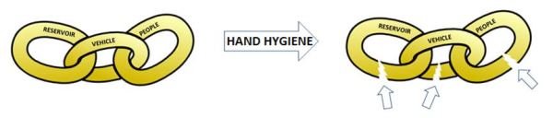
Goal of Infection Prevention and Control
To protect yourself from getting infected
To prevent the spread of illnesses to others
TO BREAK THE TRANSMISSION CHAIN!

Slide 25
Questions?
To keep updated, please look to the following Public Health organizations:
WHO: https://www.who.int/health-topics/coronavirus
CDC: https://www.cdc.gov/coronavirus/2019-ncov/index.html

