Slide 1
Coronavirus or COVID-19
General Board of Global Ministries

Slide 2
Disclaimer
All information included in this presentation is derived from US Centers for Disease Control and Prevention (CDC) and the World Health Organization (WHO).
Information pertaining to Coronavirus is subject to change per CDC and WHO guidance
This presentation was distributed on March 19, 2020

Slide 3
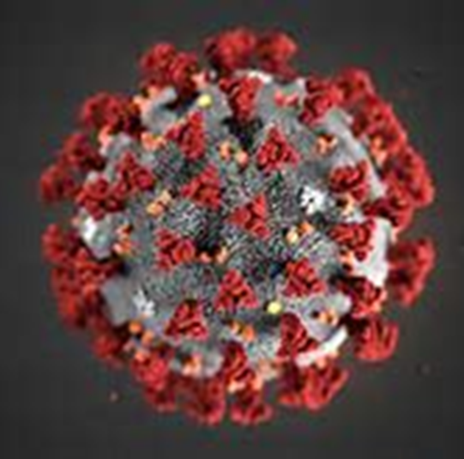
What is a novel coronavirus?
Coronavirus (CoV) are a large family of viruses, cause a wide range of illnesses from the common cold to more severe illnesses
  Examples: Severe Acute Respiratory Syndrome (SARS) and Middle East Respiratory Syndrome (MERS)
A novel coronavirus is a new strain that has not been previously identified in humans

Slide 4
History: COVID-19
December 31, 2019: The World Health Organization (WHO) was informed of pneumonia cases of unknown causes in Wuhan City
January 7, 2020: A novel coronavirus was isolated as the cause
January 21, 2020: First case of COVID-19 in the US detected
January 30, 2020: WHO declared “Public Health Emergency of International Concern”
March 11, 2020: WHO declares COVID-19 a pandemic
  Over 118,000 cases of the coronavirus illness in over 110 countries and territories around the world and the sustained risk of further global spread

Slide 5

Countries affected:
Last Updated 3/19/2020: Click picture to access updated information

Slide 6
COVID-19
Incubation period, the period between exposure to an infection and the appearance of the first symptoms: Ranges from 1 to 14 days¹
  Averages about 5 to 6 days
Mode of transmission: Droplets and contaminated surfaces¹
Transmission: Human to human²
Treatment: Currently no vaccination, trying several treatments that are found effective for viruses, treatment of symptoms¹
1: This information is subject to change.
2: In majority of cases

Slide 7
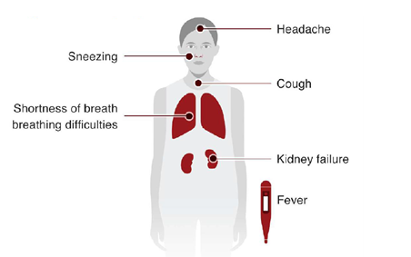
COVID-19 Signs and Symptoms
Illness appears to start with fever,
Followed by a dry cough
Can lead to shortness of breath
Some patients may need to be hospitalized.

Slide 8
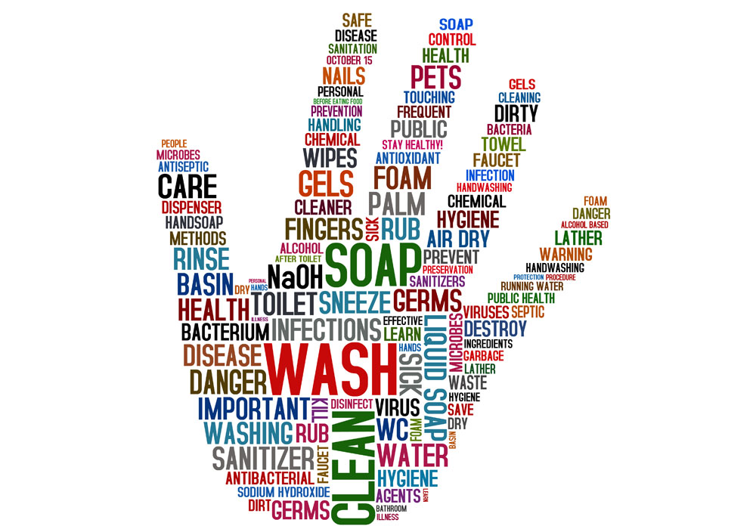
Infection Prevention and Control

Slide 9
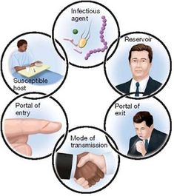
How do colds and viruses spread?
For an infection to spread, all links must be connected
Breaking any one link, will stop disease transmission!

Slide 10
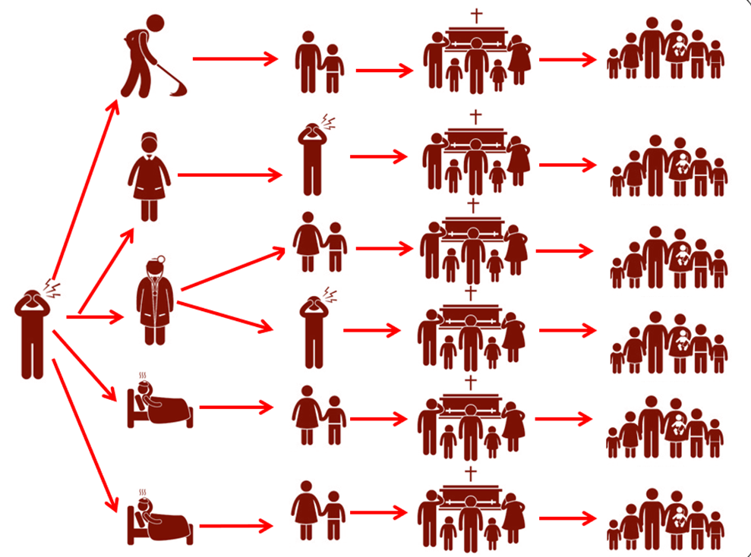
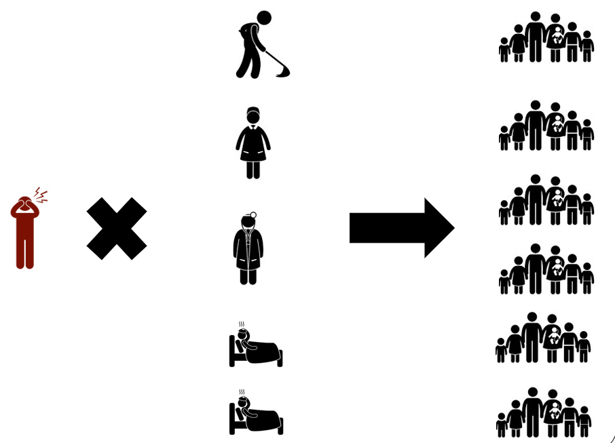
Infection Prevention and Control (IPC)
Without breaking the transmission chain
With breaking the transmission chain

Slide 11
Stop COVID-19 Transmission
Protect yourself- you are valuable
Protect your community-
they are counting on you
Protect your patient-
show you care, its your mission

Slide 12
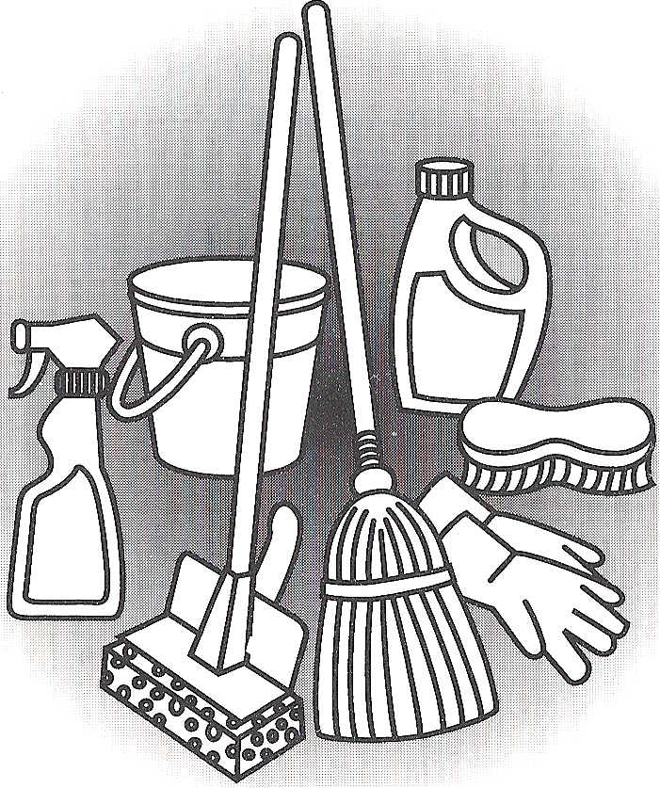




Basic Prevention Measures
Cleaning
Social distancing
Respiratory hygiene
Hand hygiene
Healthcare workers wearing proper Personal Protective Equipment

Slide 13
Hand Hygiene

Slide 14

Frequently clean your hands…
When your hands are visibly dirty:
  Use soap and water
When your hands are not visibly soiled:
  Use alcohol-based hand rub (Hand sanitizer)
    or
  Soap and water
  Washing hands is the BEST way to prevent the spread of
  infections!!

Slide 15
When to perform hand hygiene?
When should you clean your hands? | Before | During | After
Preparing food
Eating
Blowing nose, coughing and sneezing
Caring for someone
Touching animals, animal feed, animal waste
Touching garbage
Using the toilet
Touching money
Touching your face and nose

Slide 16
When to perform hand hygiene?
When should you clean your hands? | Before | During | After
Preparing food | ü | ü | ü
Eating | ü |  | ü
Blowing nose, coughing and sneezing |  |  | ü
Caring for someone | ü | ü | ü
Touching animals, animal feed, animal waste |  |  | ü
Touching garbage |  |  | ü
Using the toilet |  |  | ü
Touching money |  |  | ü
Touching your face and nose | ü |  | ü

Slide 17
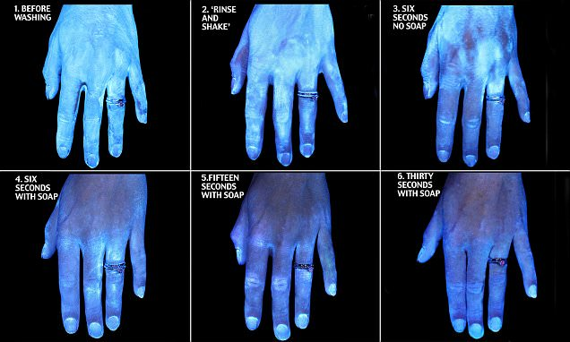
GloGerm Presentation
Please note that at 30 seconds, germs are still present on the hands.

Slide 18
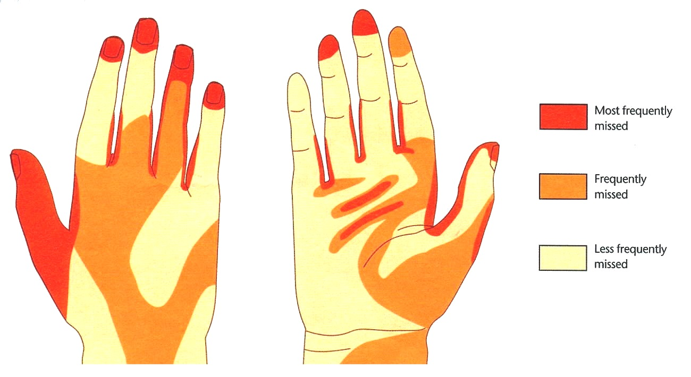
Parts of the Hand that are Usually
Not Washed Properly
Most frequently missed
Frequently missed
Least frequently missed
Back of hand
Front of hand
The use of gloves does NOT replace the need to wash hands. Hand hygiene must be performed after removing gloves.
Notes:
Talking Points: Take a look at this diagram. It shows the parts of the hand that are usually not washed properly. Think about your usual way of hand washing. I think that I have missed these spots on occasion. Would you have missed these spots?
Let’s go through the steps for proper hand washing.

Slide 19
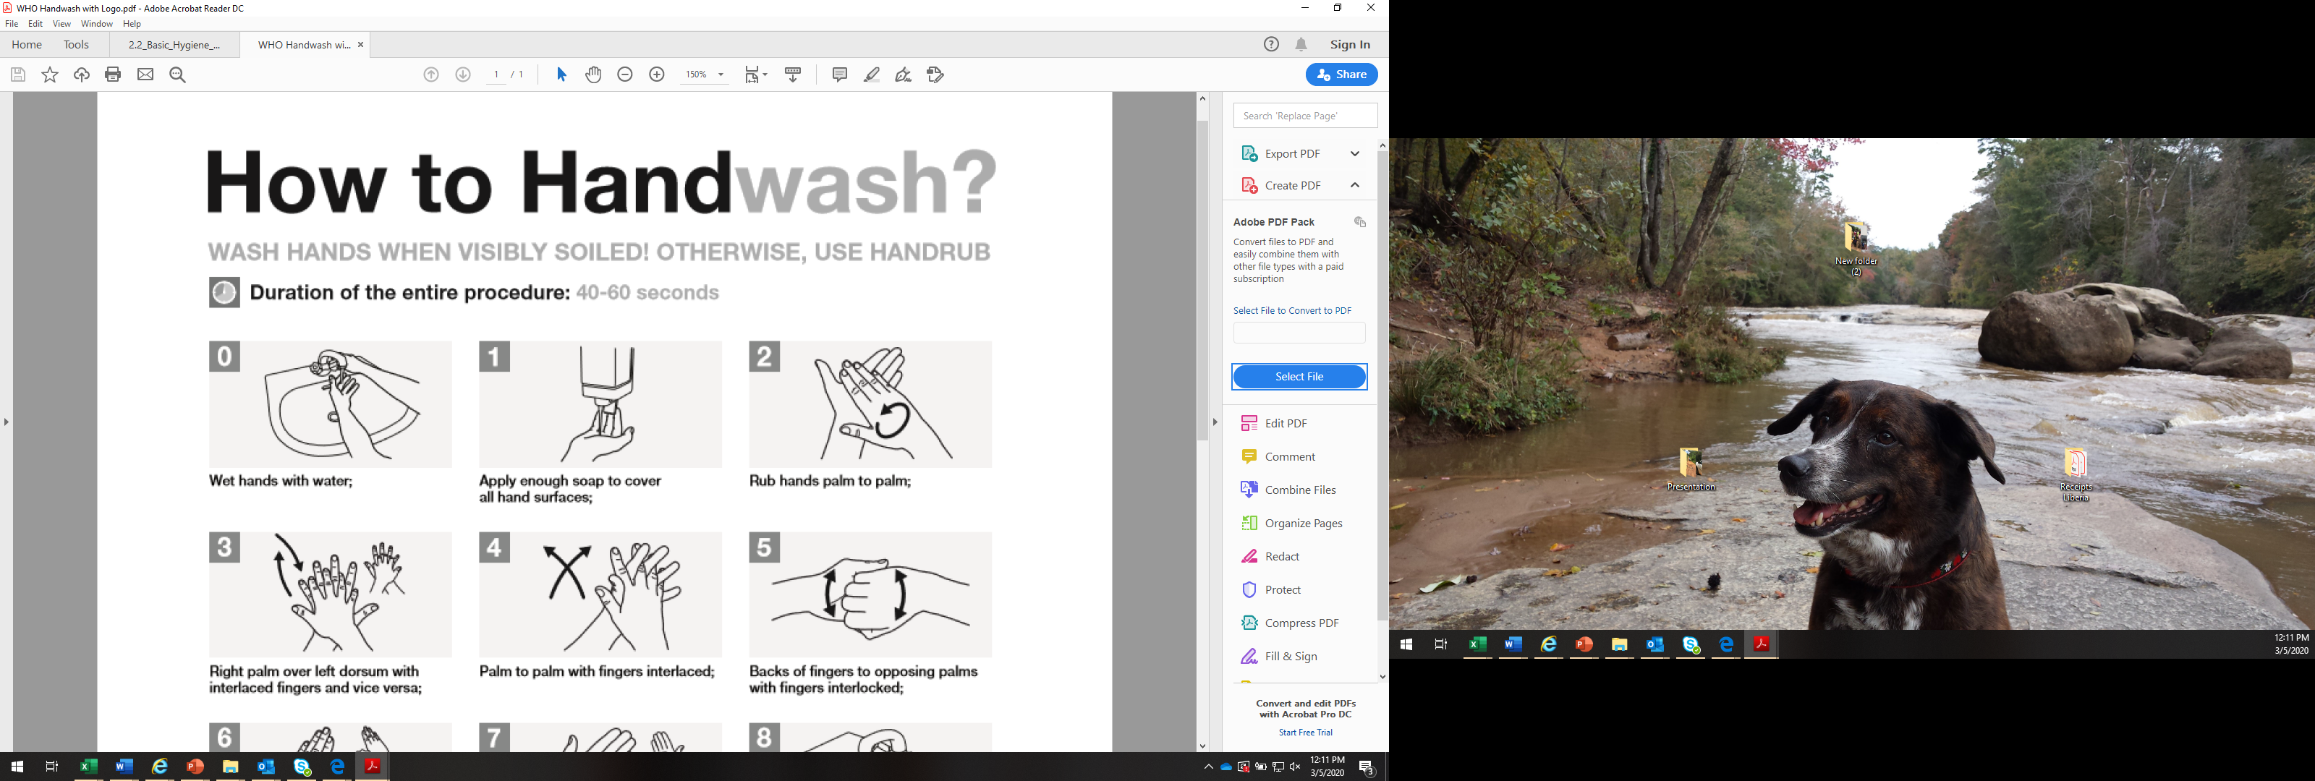
Notes:
We are going to teach you a way to wash your hands that we call the Handwashing Prayer. It is something you should do over and over all day long and you should think of it as a prayer to keep you safe. Lets do the handwashing prayer together!
Everybody put your hands up! **Look at the clock
Activity: Handwashing prayer with hands in the air.
*Explain why you do each step and what parts of the hand you are cleaning. For example the 5th step is to clean the back of the nails, 7th step is to get under the nails.
*can add wrists as 8th step
Break for tea (real handwashing before hand)

Slide 20
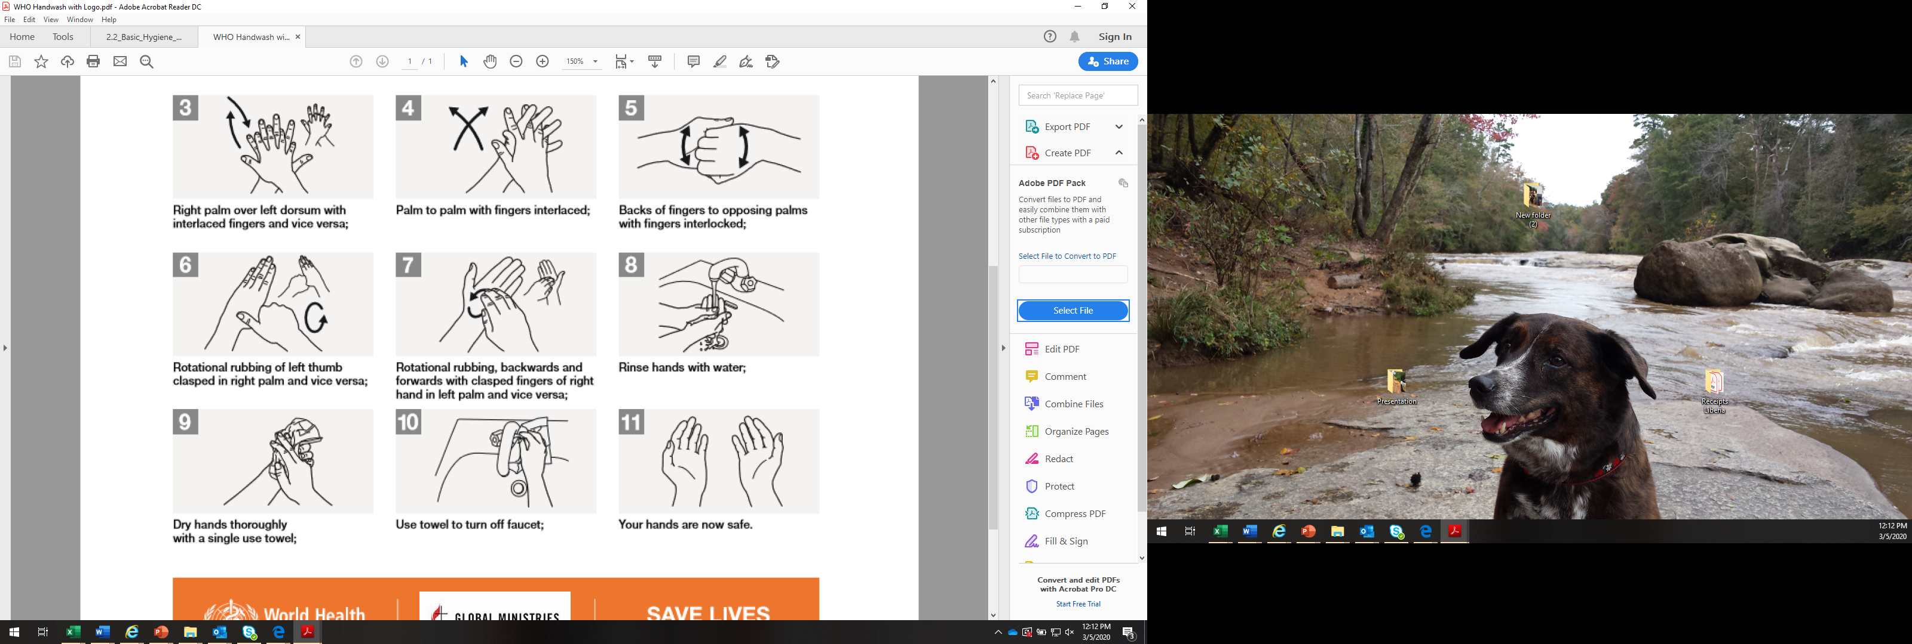

Slide 21
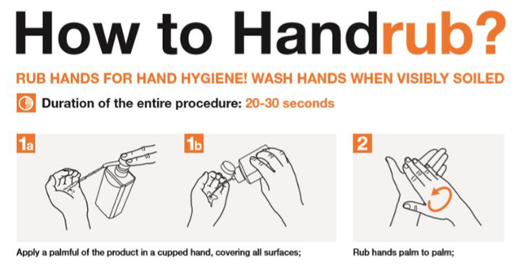

Slide 22
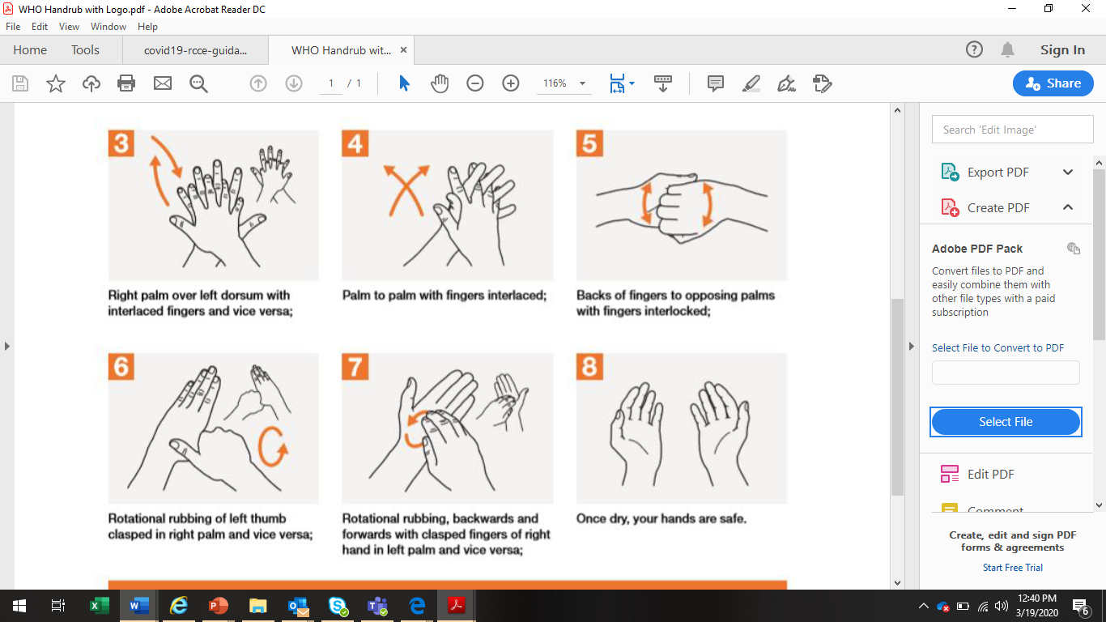

Slide 23
Personal Protective Equipment (PPE)

Slide 24
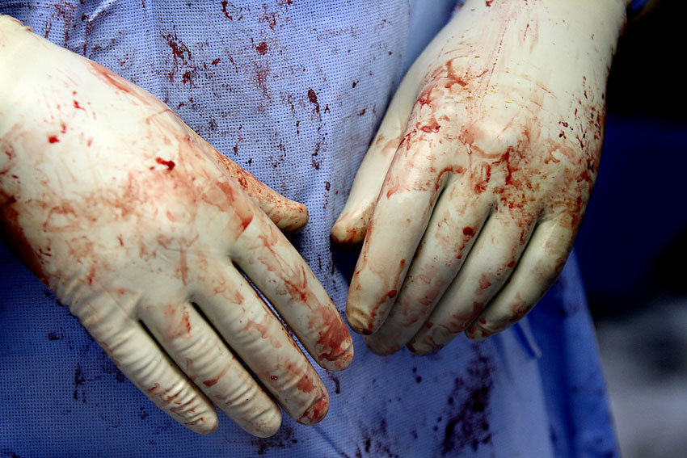
What is Personal Protective Equipment?
PPE is
  “specialized clothing or equipment worn by an employee for protection against infectious materials” Occupational Safety and Health Administration (OSHA)

Slide 25
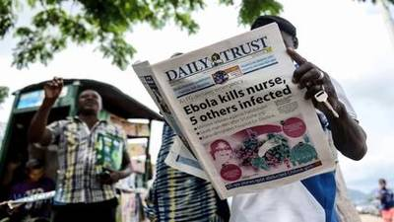
What is the Goal of PPE Use in Healthcare Settings?
  To improve personnel safety in the healthcare environment

Slide 26
Coronavirus Recommended PPE
Health care workers involved in the direct care of patients should use the following PPE:
  Gowns,
  Gloves,
  Surgical/medical mask, and
  Eye protection (goggles or face shield)

Slide 27
Putting on PPE

Slide 28
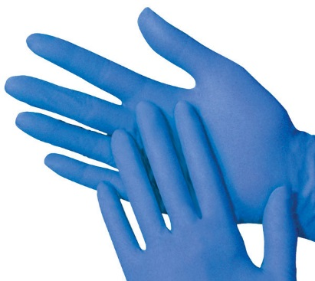
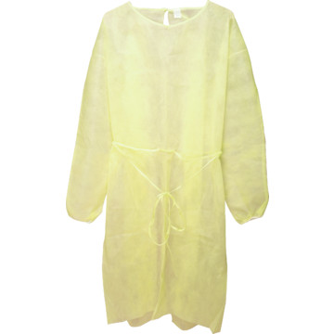
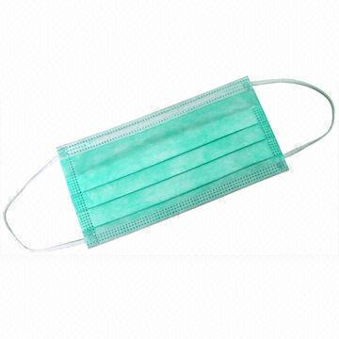
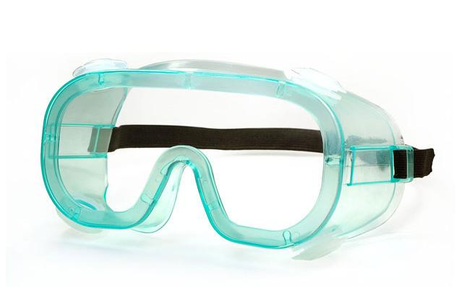
What is the Correct Order for Putting on a PPE?
_____________
_____________
_____________
_____________
*Combination of PPE will affect sequence – be practical
Notes:
The gown should be donned first. The mask or respirator should be put on next and properly adjusted to fit; remember to fit check the respirator. The goggles or face shield should be donned next and the gloves are donned last. Keep in mind, the combination of PPE used, and therefore the sequence for donning, will be determined by the precautions that need to be taken.

Slide 29
What is the Correct Order for Putting on a PPE?
Gown
Mask/Respirator
Googles/Face shield
Gloves
*Combination of PPE will affect sequence – be practical
Notes:
The gown should be donned first. The mask or respirator should be put on next and properly adjusted to fit; remember to fit check the respirator. The goggles or face shield should be donned next and the gloves are donned last. Keep in mind, the combination of PPE used, and therefore the sequence for donning, will be determined by the precautions that need to be taken.

Slide 30
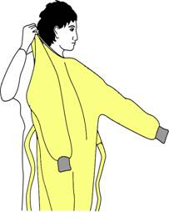
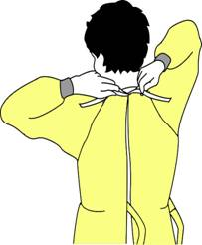
How to Put on a Gown
Select appropriate type and size
Opening is in the back
Secure at neck and waist
If gown is too small, use two gowns
  Gown #1 ties in front
  Gown #2 ties in back

Slide 31
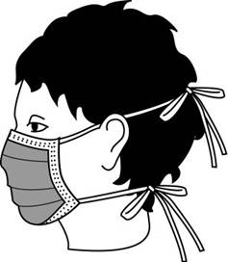
How to Put On a Surgical Mask
Place over nose, mouth and chin
Fit flexible nose piece over nose bridge
Secure on head with ties or elastic
Adjust to fit

Slide 32
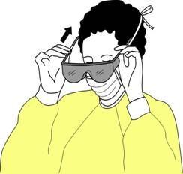
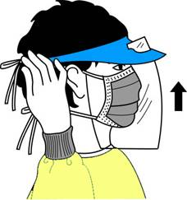
How to Put On Eye and Face Protection
Position goggles over eyes and secure to the head using the earpiece or headband
Position face shield over face and secure on brow with headband
Adjust to fit comfortably

Slide 33
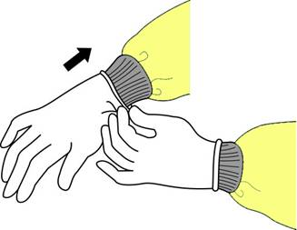
How to Put On Gloves
Put on gloves last
Select correct type and size
Insert hands into gloves
Extend gloves over isolation gown cuffs

Slide 34
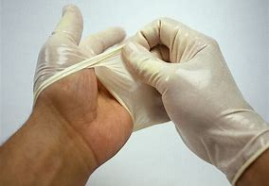
Removing PPE

Slide 35
What is the Correct Order for Removing PPE?
_____________
_____________
_____________
_____________
*Combination of PPE will affect sequence – be practical
Notes:
The gown should be donned first. The mask or respirator should be put on next and properly adjusted to fit; remember to fit check the respirator. The goggles or face shield should be donned next and the gloves are donned last. Keep in mind, the combination of PPE used, and therefore the sequence for donning, will be determined by the precautions that need to be taken.

Slide 36
What is the Correct Order for Removing PPE?
Gloves
Googles/Face shield
Gown
Mask/Respirator
*Combination of PPE will affect sequence – be practical
Notes:
The gown should be donned first. The mask or respirator should be put on next and properly adjusted to fit; remember to fit check the respirator. The goggles or face shield should be donned next and the gloves are donned last. Keep in mind, the combination of PPE used, and therefore the sequence for donning, will be determined by the precautions that need to be taken.

Slide 37
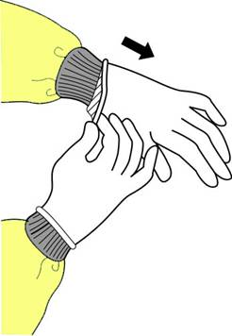
How to Remove Gloves
Grasp outside edge near wrist
Peel away from hand, turning glove inside-out
Hold in opposite gloved hand

Slide 38
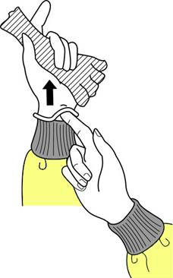
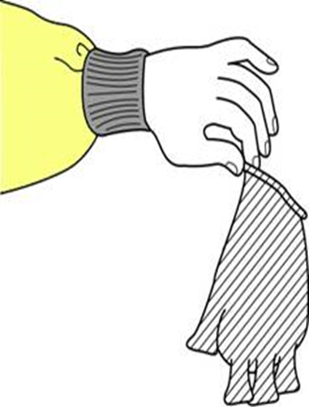
How to Remove Gloves (cont.)
Slide ungloved finger under the wrist of the remaining glove
Peel off from inside, creating a bag for both gloves
Discard

Slide 39

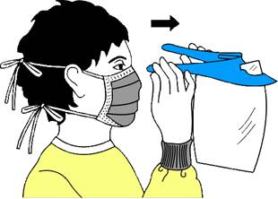
How to Remove Goggles or Face Shield
Grasp ear or head pieces with ungloved hands
Lift away from face
Place in designated receptacle for reprocessing or disposal

Slide 40
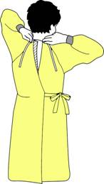
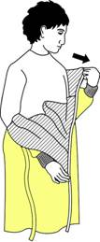
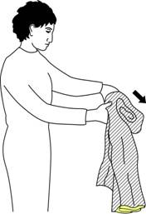
How to Remove an Isolation Gown
Unfasten ties
Peel gown away from neck and shoulder
Turn contaminated outside toward the inside
Fold or roll into a bundle
Discard

Slide 41
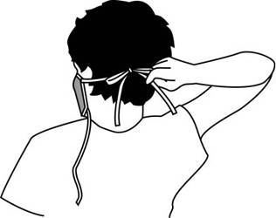
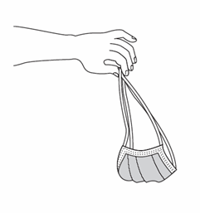
How to Remove a Mask
Untie the bottom tie, then top tie
Remove from face and discard

Slide 42
Cleaning

Slide 43
Why is it Important?
Coronavirus is thought to live on surfaces (tables, chairs)
Coronavirus is thought to live on medical equipment (thermometer, stethoscope)
You can kill Coronavirus through proper cleaning
Notes:
Talking points:
Why is it important to clean the clinic or hospital?
Ebola can live on surfaces such as tables, chairs, beds, handrails, door handles, etcetera.
Ebola can also live on medical equipment such as thermometers and stethoscopes
Ebola can live a long time in body fluids such as blood, vomit, urine, stool

Slide 44
Chlorine Solution Strengths
Strong (0.5%) chlorine solution
  For cleaning (buckets, medical equipment)
  For cleaning up spills (blood, urine, vomit, stool)
Weak (0.05%) chlorine solution
  Mostly for washing your bare hands
  For soaking reusable PPE (aprons, gloves, boots, goggles)
Notes:
SAY: There are two types of chlorine solutions: A strong one, which is called 0.5% solution—this solution is used to clean walls, floors, tables, chairs, bathrooms, and medical equipment. The second type of solution is a more dilute, weaker chlorine solution, called 0.05% solution, that is used for washing hands. The strong solution cannot be used on bare hands because it can cause your skin to burn. It is important to make both kinds of solutions every day for use in the health facility.

Slide 45
Chlorine Solution
Chlorine loses strength with time
  Everyday throw out the old chlorine solution
  Everyday make new chlorine solution
Sunlight weakens chlorine solution
  Keep the chlorine solution away from sunlight
Notes:
SAY: It is important that you make chlorine solution everyday.
Chlorine loses strength over time.
Everyday throw out the old chlorine solution left over from the previous day make new chlorine solution every morning
Sunlight can also weaken chlorine solution
Keep the chlorine solution away from direct sunlight

Slide 46
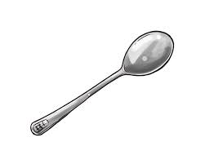
How to Make Strong (0.5%) Chlorine Solution
Chlorine solutions of 0.5% should be used for DISINFECTING OBJECTS (floors, counters, bedrails, medical equipment)
Make chlorine solution every day. If chlorine solution is more than 1 day old, throw it away
STIR WITH A STICK FOR 10 SECONDS
20 Liters Water
10 OVERFLOWLY TABLESPOONS OF BLEACH
Label the bucket: “STRONG (0.5%) CHLORINE SOLUTION”
WAIT 30 MINUTES BEFORE USE
WARNING: Chlorine can burn. Always wear gloves and goggles when handling chlorine granules and strong solutions! This mixture is variable due to bleach concentration used.
Notes:
POSTER
ACTIVITY: GO THROUGH THE ACTIVITY OF MAKING THIS CHLORINE SOLUTION USING THE POSTER AS AN AID. After a bucket is made, have them fill up a spray bottle with the solution
SAY: You may need to make many buckets of bleach in a day because you will be using them for multiple purposes such as cleaning surfaces, cleaning dishes and cleaning medical equipment and non-disposable PPE at the end of each day.

Slide 47
Important Things to Remember
When Cleaning
NEVER dip a dirty towel into a bucket of chlorine
DO NOT clean or wipe surfaces with a dry towel
DO NOT reuse towels, use disposable towels only
Move slowly, DO NOT splash or spray
Notes:
SAY: There are several important principles for cleaning:
First, never dip a dirty towel into a bucket of chlorine. You MUST GET a pour bottle filled up with the chlorine to pour over your towels or surfaces. You can also use spray bottles.
Never wipe up any surfaces with a dry towel. Always moisten the towel with chlorine.

Slide 48


Social Distancing

Slide 49
Social Distancing: Healthcare Facility
Wear proper Personal Protective Equipment (PPE)
Minimize unnecessary close contact with patients
If not wearing PPE, stay at least one meter away from patients
Keep patients and their beds at least one meter apart in waiting room and inpatient rooms
Minimize visitors to health facilities
Notes:
Talking points:
During the Time of Ebola, things are Turned Upside Down. We do not want to greet or touch people we normally would- and we do not want to touch anyone who is sick.
This is basic precautions you can take any time, any place. You do not need special equipment for this.
You should practice this all the time- at home too, in crowds. Be a role model.
Tell:
You should not touch others you do not know.
You should not touch people who are sick without proper PPE (including friends and family members)
Ask:
What IS touching? Sleeping in same bed, touching shoulders, handshake, hug, kiss, etc. (let them tell you- write it on flip paper)

Slide 50
Social Distancing: Selfcare
Reduce the time spent in crowded places, as the likelihood of coming in contact with people who are ill is greater
Keep distance of at least one meter from people who are coughing or sneezing
Avoid touching, hugging, shaking hands or kissing people that are sick
Do not come to work if you have a fever equal or greater than 37.8^{oC} and/or have an active cough

Slide 51
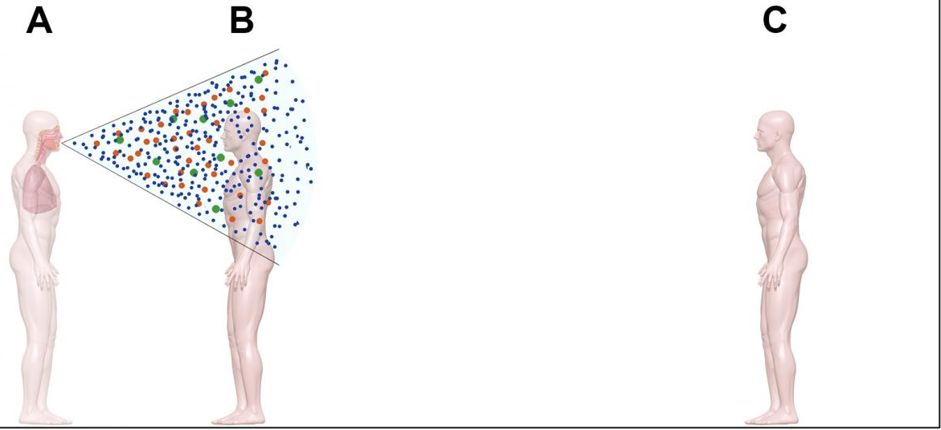
Droplets
Usually generated when a person coughs, sneezes or talks
Travel only short distances through the air as they are larger and heavier
Do not remain suspended in the air
Person A is sick with a respiratory illness
Person B is standing within 1 meter from person A when s/she coughs
Person C is standing more than 1 meter away and is protected from the virus

Slide 52
Respiratory Hygiene

Slide 53
Respiratory Hygiene: Patient and Self
Cover mouth and nose with a disposable tissue when coughing or sneezing
  Discard the tissue immediately into a no-touch waste bin
  Wash your hands afterwards
If you don’t have a tissue, sneeze into your elbow
Patients who are coughing: To wear surgical/medical mask
Healthcare workers: To wear surgical mask when providing care

Slide 54

Goal of Infection Prevention and Control
To protect yourself from getting infected
To prevent the spread of illnesses to others
TO BREAK THE TRANSMISSION CHAIN!

Slide 55
Questions?
To keep updated, please look to the following Public Health organizations:
WHO: https://www.who.int/health-topics/coronavirus
CDC: https://www.cdc.gov/coronavirus/2019-ncov/index.html

Slide 56
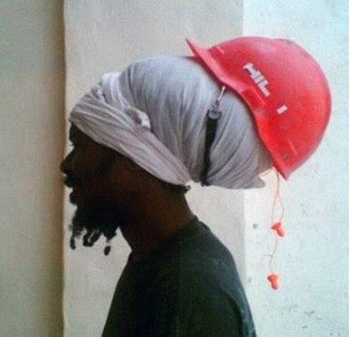
Mistakes Using PPE
&
PPE Alternatives

Slide 57
Learning Objectives
At the end of this session, the participant will be able:
  Identify common PPE mistakes and explain the correct action to take when a mistake is identified
  Explain how to adapt materials when PPE is limited

Slide 58
Example 1: Find the PPE Mistake
Problem
Correct Action
Holding phone with gloves on
Do not pick up objects (phones, pens, books, patient files, etc.) while wearing PPE
Remove gloves, perform hand hygiene, then pick up objects

Slide 59
Example 2: Find the PPE Mistakes
Problem
Correct Action
Face mask not covering nose and mouth
Gloves visibly dirty
Wearing PPE outside of the healthcare area
Ensure face mask fully covers nose and mouth and adjust to fit
Remove PPE before leaving healthcare facility area

Slide 60
Exercise 3: Find the PPE Mistake
Problem
Correct Action
Incorrect method of removing first glove
When removing gloves, grasp first glove at palm and peel off

Slide 61
No Gloves Available?
If gloves are not available, what would you do?
  Use plastic bags attached and closed with tape or elastic bands
  Make sure there are no holes prior to use
  Dispose in the medical waste bin after use

Slide 62
No Gown Available?
If gowns or coveralls are not available, what would you do?
Wear a cotton surgical gown that can be washed and reused
Alternatively, you can get gowns sewn from local fabric. Gowns must be:
  Open at the back and close with ties at the neck and waist
  Knee-length with collar wraps around the neck and elastic bands to close the gown around the wrist

Slide 63
No Aprons Available?
If aprons are not available, what would you do?
  Make aprons from plastic sheeting, large trash bags, rubber coated, or plastic cloth normally used to cover kitchen tables
  The apron should:
    Be impermeable to liquid
    Have hooks or ties that fasten around the neck
    Have ties at the waist that reach around and tie at the back
    Be long enough to cover the top of the boots to provide additional protection from spills running inside boots

Slide 64
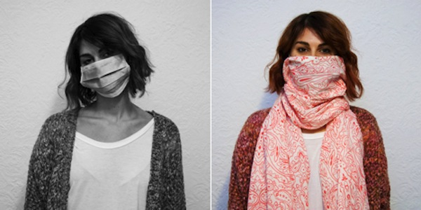
No Masks Available?
If a disposable mask is not available, what would you do?
Use a clean large cloth, such as a scarf or other material to cover the mouth and nose
  Make sure it is tied securely

Slide 65
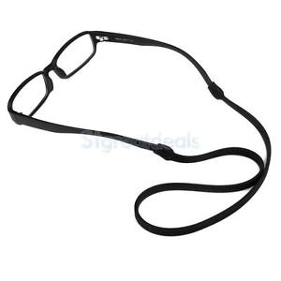
No Goggles or Face Shield Available?
If goggles or a face shield are not available, what would you do?
Obtain eyeglasses with clear lenses from a local eyeglass shop or in the market
  Place ties on the ear holders
  Tie the eyeglasses around the back of the head so they will not fall off when a healthcare worker bends over a patient

